Slide 1
Stock Analysis and Selection Tool
Stock Selection Using Hedge Fund Quarterly 13F Filings
By: David Lifschitz, Judah Levy, Yaakov Bienstock, and Sam Drazin
August 5th, 2021

Slide 2
Introduction
By: David Lifschitz, Judah Levy, Yaakov Bienstock, and Sam Drazin
August 5th, 2021

Slide 3

Overview of the Summer Program
Summer program at Yeshiva University
Provide students with exposure to advanced concept and experience building real-world applications
Projects guided by accomplished industry mentors
By: David Lifschitz, Judah Levy, Yaakov Bienstock, and Sam Drazin
August 5th, 2021

Slide 4

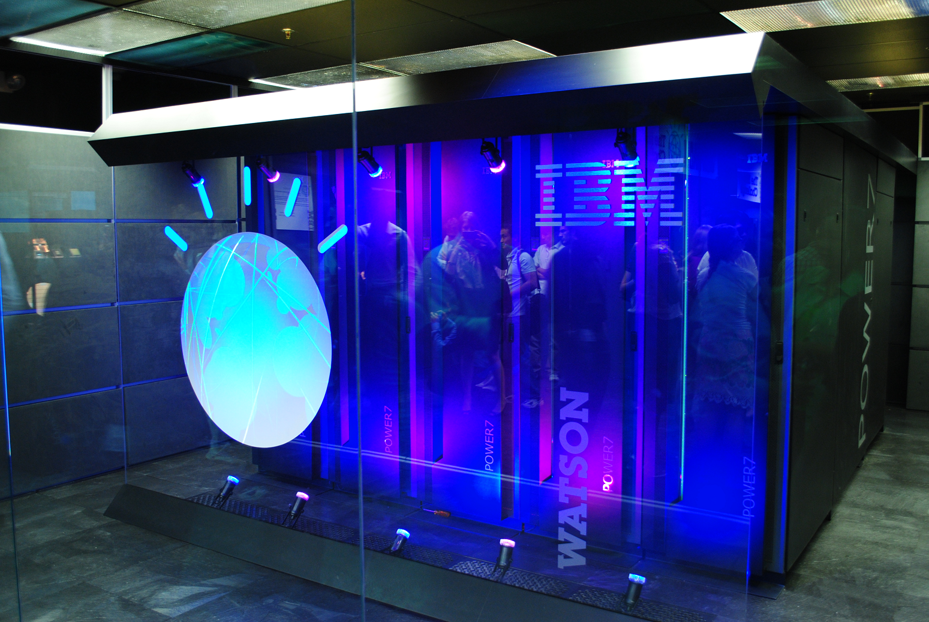
Our Team
This group consists of post 1st- and 2nd- year students specializing in Data Science:
David Lifschitz, post 2nd-year student
Judah Levy, post 1st-year student
Yaakov Bienstock, post 1st-year student
Sam Drazin, post 1st-year student
Mentor: Dr. Aliza Heching
Research Staff Member at IBM TJ Watson Research Center. Consulted extensively with internal IBM divisions and external clients.
By: David Lifschitz, Judah Levy, Yaakov Bienstock, and Sam Drazin
August 5th, 2021

Slide 5


Basic Goals
Build a tool for stock analysis and stock selection by imitating hedge funds
Hedge fund portfolio managers are amongst the most successful investors in the world
They are regulated more lightly than mutual funds
Can be far more aggressive in their investment strategies
Gather data from hedge funds’ SEC filings which are filed quarterly
Assess the stocks in which hedge funds have decided to invest
By: David Lifschitz, Judah Levy, Yaakov Bienstock, and Sam Drazin
August 5th, 2021

Slide 6



Key Steps
Determine which hedge funds to target
Find a way to access the filings
Store data
Analyze the data to obtain useful information
Return results to user
By: David Lifschitz, Judah Levy, Yaakov Bienstock, and Sam Drazin
August 5th, 2021

Slide 7
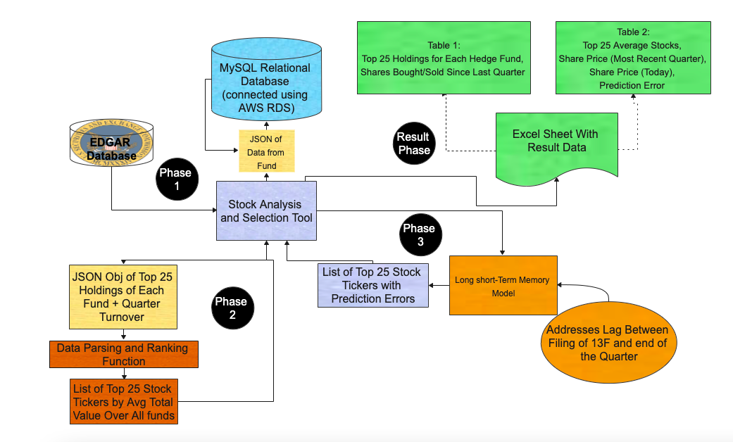
Solution as a System Architecture:
Key:
Cylinders: Databases Blue: MySQL db
Yellow: JSON obj
Purple: Python
Orange: LSTM modeling
Green: Excel Spreadsheet
By: David Lifschitz, Judah Levy, Yaakov Bienstock, and Sam Drazin
August 5th, 2021

Slide 8
Relevant Links
By: David Lifschitz, Judah Levy, Yaakov Bienstock, and Sam Drazin
August 5th, 2021
https://github.com/davidlifschitz/team-gold.git
Whatever our Youtube link will be
The link on slideshare
The link on linkedin.

Slide 9
Description
By: David Lifschitz, Judah Levy, Yaakov Bienstock, and Sam Drazin
August 5th, 2021

Slide 10
Goal
By: David Lifschitz, Judah Levy, Yaakov Bienstock, and Sam Drazin
August 5th, 2021
Build a tool for stock analysis and stock selection by imitating hedge funds
Use available public data sets: SEC Quarterly 13F filings and Yahoo Finance
Analyze consolidated data and provide end user with insight to support stock selection decision-making
Design tool so analysis can be easily updated by end user as data refreshes become available

Slide 11
Background Information
By: David Lifschitz, Judah Levy, Yaakov Bienstock, and Sam Drazin
August 5th, 2021

Slide 12
What are Hedge Funds and Why Is it a Good Idea to Copy Them?
By: David Lifschitz, Judah Levy, Yaakov Bienstock, and Sam Drazin
August 5th, 2021
Like many funds, hedge funds pool money from investors
Unlike other other types of funds, hedge funds are subject to fewer SEC regulations and are free to be aggressive
Hedge funds adopt different investment strategies:
Long/Short Equity: reduce market risk by investing in both long and short positions
Market Neutral: shorts and longs have an equal market value
Merger Arbitrage: riskier version of market neutral, returns come from takeover activity
Successful hedge fund portfolio managers are amongst the most successful investors in the world

Slide 13
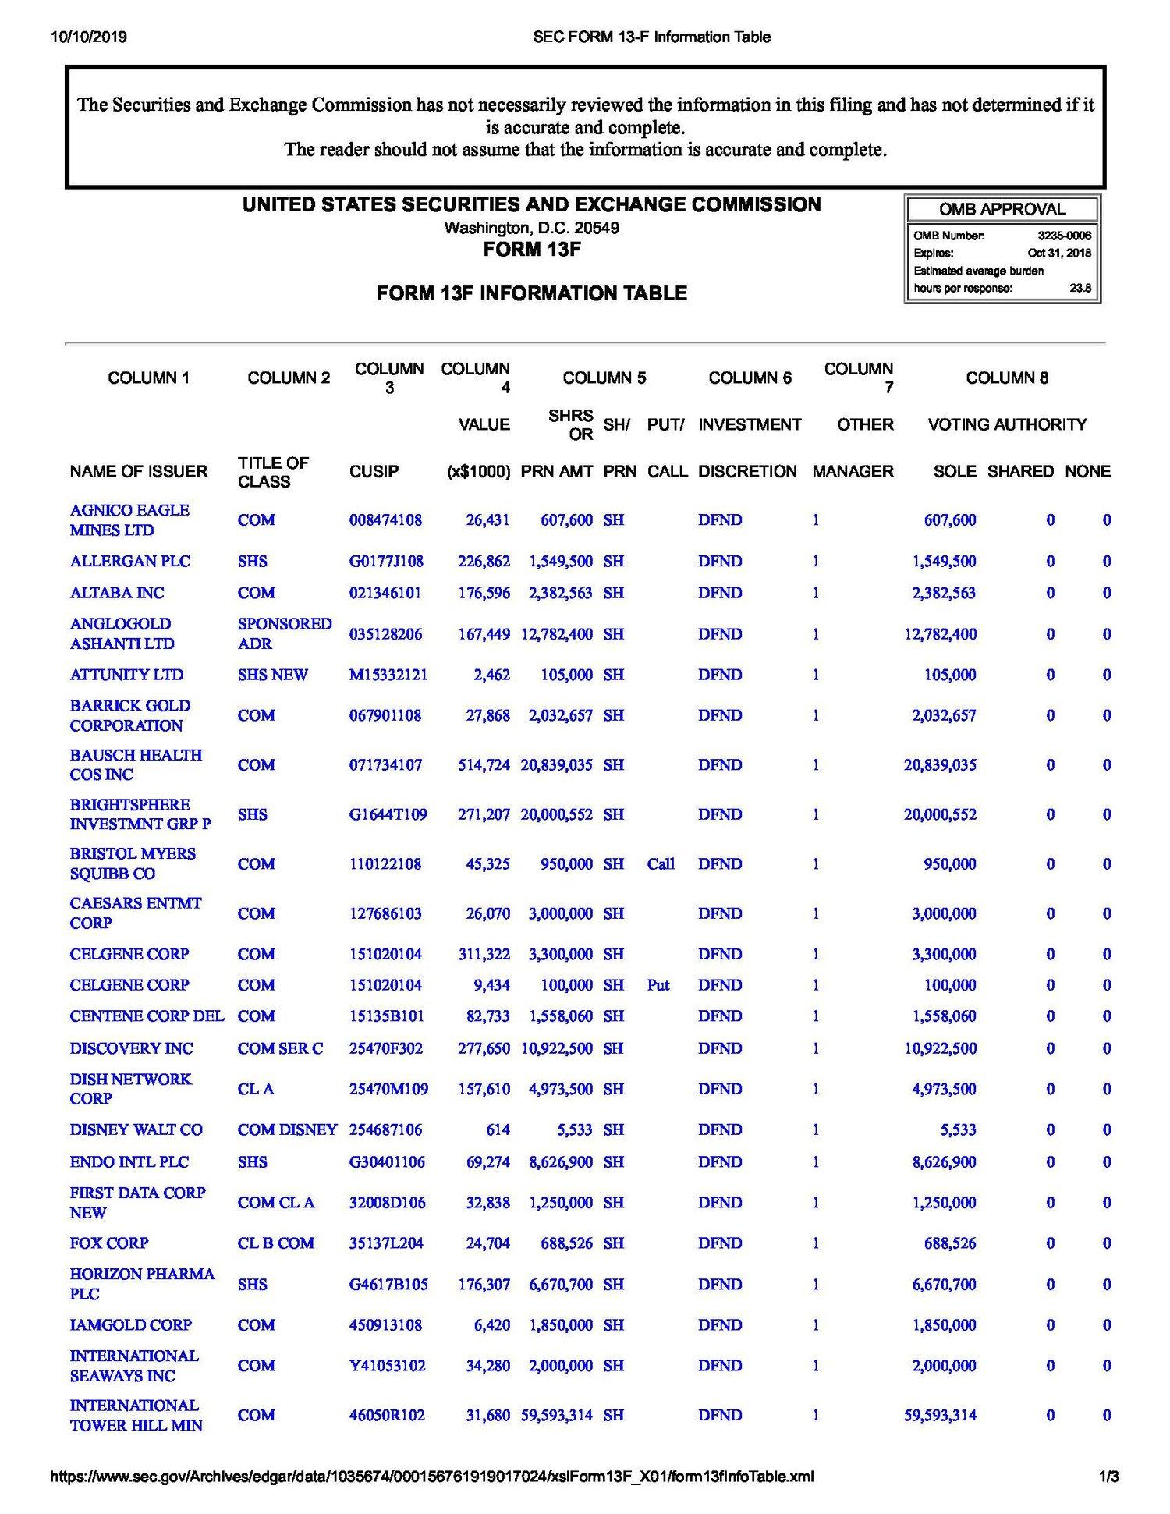
What is Form 13F?
By: David Lifschitz, Judah Levy, Yaakov Bienstock, and Sam Drazin
August 5th, 2021
The SEC’s Form 13F is a report that all institutional investment managers with at least $100 million in AUM (assets under management) must file quarterly
Key information reported:
Names of issuers the manager has invested in
Amount of shares the manager owns per issuer
Value the manager has invested in each issuer
The 13F filing offers the public insight on where the world’s best investors are putting their money
Example of Form 13F

Slide 14
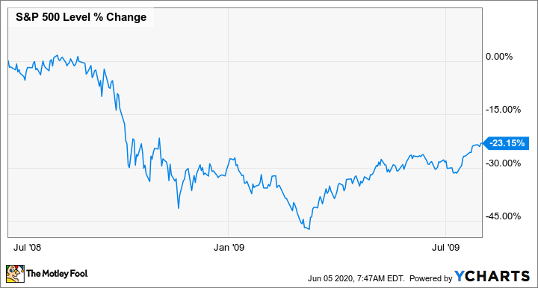
Using Form 13F Filings to Imitate Hedge Fund Managers Presents Some Challenges
By: David Lifschitz, Judah Levy, Yaakov Bienstock, and Sam Drazin
August 5th, 2021
Although 13F are filed quarterly, managers have 45 days following the end of the quarter to file the report
This means the data is normally only available 45 days after the end of the quarter
And if the most recent form 13F is accessed the data could be up to 4 ½ months behind
Stock performance may have changed between the end of quarter and the time the 13F is filed/accessed
For example, while a manager may have anticipated high growth, a stock may have declined and the manager may have sold the stock
Example of 2-month decline

Slide 15
Using Form 13F Filings to Imitate Hedge Fund Managers Presents Some Challenges (cont.)
By: David Lifschitz, Judah Levy, Yaakov Bienstock, and Sam Drazin
August 5th, 2021
Managers are only required to report certain securities in their portfolios, such as long positions and US securities
Some hedge funds’ strategies consist of shorting stocks, or investing in both long and short positions (long/short equity)
Reporting lag and limited reporting requirements must be considered when using 13F filings to guide stock selection

Slide 16
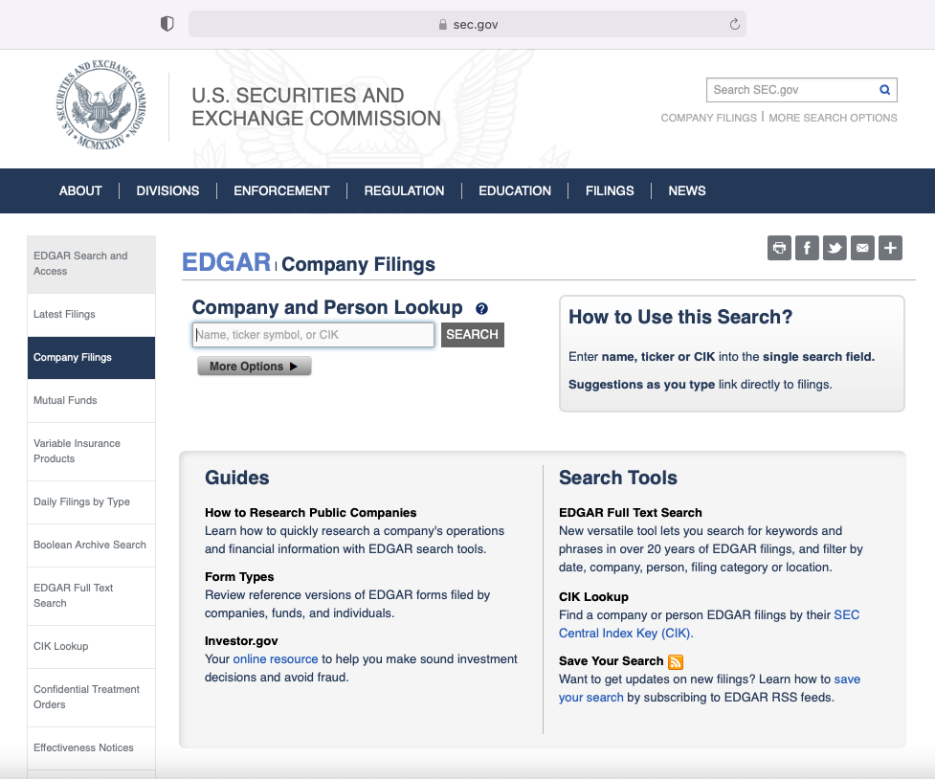
Form 13F can be accessed
via EDGAR
By: David Lifschitz, Judah Levy, Yaakov Bienstock, and Sam Drazin
August 5th, 2021
EDGAR ( Electronic Data Gathering, Analysis, and Retrieval system) is the main system for companies filing legally mandated documents with the SEC
The public has free access to EDGAR’s public database consisting of these submissions
https://www.sec.gov/edgar/search-and-access
EDGAR company filings page, https://www.sec.gov/edgar/searchedgar/companysearch.html

Slide 17
Build and Deploy
By: David Lifschitz, Judah Levy, Yaakov Bienstock, and Sam Drazin
August 5th, 2021

Slide 18
Steps to Build and Deploy Stock Analysis and Selection Tool
By: David Lifschitz, Judah Levy, Yaakov Bienstock, and Sam Drazin
August 5th, 2021
Identify hedge funds that are candidates for copying
Build relational database to store data (e.g., 13F data, stock ticker data)
Use python package to pull 13F filing data from EDGAR into relational database
Identify stocks to consider for investment by querying database for highest-ranked stocks
Assess performance of target stocks during lag between end of quarter and 13F filing
Produce scored list of suggested stocks for investment

Slide 19
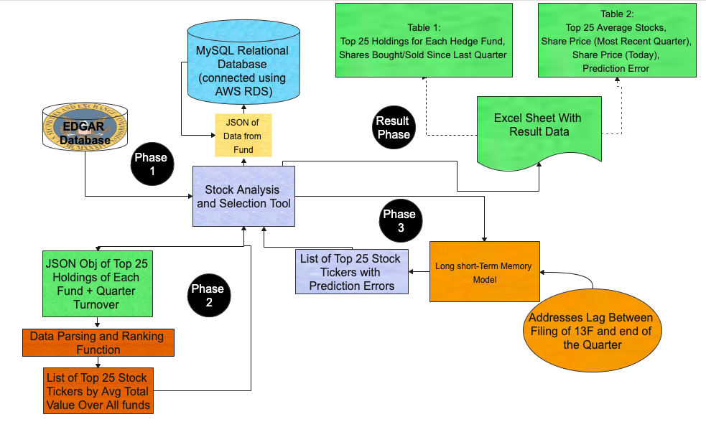
System and Architecture Diagram
By: David Lifschitz, Judah Levy, Yaakov Bienstock, and Sam Drazin
August 5th, 2021

Slide 20



1. Identify Hedge Funds That Are Candidates For Copying
By: David Lifschitz, Judah Levy, Yaakov Bienstock, and Sam Drazin
August 5th, 2021
Focus on hedge funds with:
a proven track record
low turnover - to help overcome the 13F filing lag
long-biased strategy (only long positions reported in 13F)

Slide 21
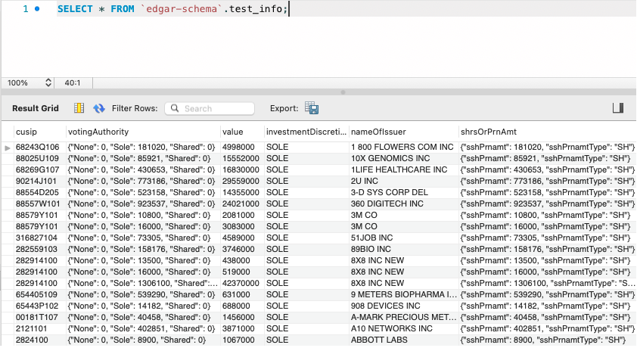
2. Build Relational Database to Store Data (e.g., 13F data, stock ticker data)
By: David Lifschitz, Judah Levy, Yaakov Bienstock, and Sam Drazin
August 5th, 2021
Once hedge funds have been identified, build database to store and manipulate hedge fund data including historical 13F filings
Build MySQL relational database using Amazon Web Services RDS
A relational database is a collection of pieces of data with a relationship between them, organized in a table
Hedge funds’ data is best stored in a relational database
Requirements:
MySQL
AWS account (or a similar service)
Example of MySQL database

Slide 22
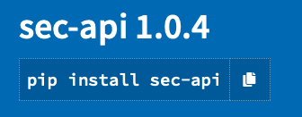
3. Use Python Package to Pull 13F Filing Data from EDGAR Into Relational Database
By: David Lifschitz, Judah Levy, Yaakov Bienstock, and Sam Drazin
August 5th, 2021
Use SEC-API¹ Python package to pull 13F filing data
Use the API to query from all SEC filings
SEC assigns each fund a unique CIK number (Central Index Key)
Identify each fund’s CIK number to query fund’s filings
API outputs JSON object with all fund’s holdings
Parse through and insert holding into database
¹https://pypi.org/project/sec-api/

Slide 23
4. Identify Stocks to Consider for Investment by Querying Database for Highest-Ranked Stocks
Query database for each fund’s top 25 holdings in most recent quarter
Ranked by total value the fund has invested in each holding
Query also outputs each stock’s turnover from prior to most recent quarter
Assign weight to stock’s position in each fund’s top 25
For example, stocks ranked 1-5 are assigned 5 points, stocks ranked 6-10 are assigned 4 points, etc.
Average each stock’s weight across all funds
Return list of top 25 stocks averaged across all funds
By: David Lifschitz, Judah Levy, Yaakov Bienstock, and Sam Drazin
August 5th, 2021

Slide 24
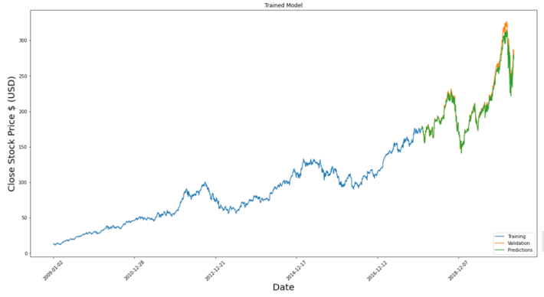
5. Assess Performance of Target Stocks During Lag Between End of Quarter and 13F Filing Date
By: David Lifschitz, Judah Levy, Yaakov Bienstock, and Sam Drazin
August 5th, 2021
Run LSTM (Long Short-Term Memory) prediction from end of quarter based on this tutorial¹
LSTM offers precise predictions which can easily be compared to actual stock prices
Gather historical stock price data set from Yahoo Finance
Establishes behaviour of stock prices
Predicts future stock prices based on historical behaviour
Compare predictions to actual stock prices to assess whether investments performed as expected during lag period
LSTM prediction model gives daily predictions
Find difference between predicted stock price and actual stock price on each day
Calculate percent error:
100 * (predicted - actual)
actual
Example of LSTM prediction
¹https://www.datasciencecentral.com/profiles/blogs/stock-price-prediction-using-lstm-long-short-term-memory

Slide 25
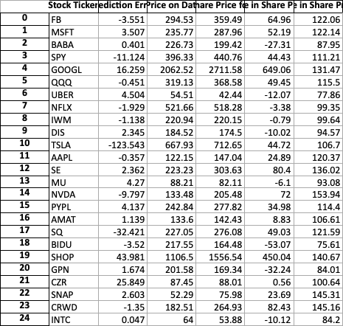
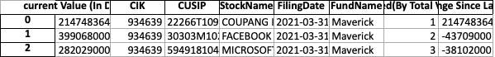
6. Produce Scored List of Suggested Stocks for Investments
Print Excel sheet consisting of 2 tables
Table 1: top 25 holdings of each fund, ranked by highest total value invested in each holding
Table 2: list of top 25 stocks averaged across all funds calculated above along with prediction percent error for each stock (e.g. 5 means the stock performed 5% better than predicted, -5 means stock performed 5% worse than predicted)
...
Table 2
Piece of table 1
By: David Lifschitz, Judah Levy, Yaakov Bienstock, and Sam Drazin
August 5th, 2021

Slide 26
We Want To Improve Our Stock Analysis and Selection Tool
As of now the all hedge funds are hardcoded into the database and the top 25 stocks are taken from all of the funds. We would like the user to have the flexibility to choose hedge funds
We would like to offer the user more insight in the stock’s potential, having the LSTM prediction model not only predict from the end of the quarter until today but how the stock is predicate to perform in the future
We would like to have a developed user interface application which allows users to make all decisions throughout the building and deploying of our Stock Analysis and Selection Tool
For example: decisions such as which hedge funds to include in the database, how many stocks to target, how many years of data the LSTM prediction model should study to assess stock price behaviour
By: David Lifschitz, Judah Levy, Yaakov Bienstock, and Sam Drazin
August 5th, 2021

